Slide 1
Session 1
Introduction to ASP.NET and ASP.NET Core

Slide 2
Session Overview
Explain the ASP.NET Framework
List the features ofASP.NET and its uses
Describe the ASP.NET page lifecycle
Explain ASP.NET Core
List the advantages of ASP.NET Core
Explain the difference between ASP.NET and ASP.NET Core

Slide 3
Introduction to ASP.NET
Microsoft developed Active Server Pages (ASP) to facilitate dynamic Web content.
ASP was then replaced by ASP.NET, a technology working on the .NET platform to facilitate modern application development.

Slide 4
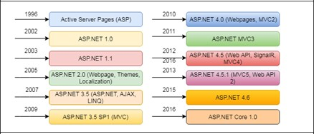
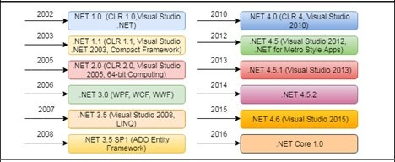
History of ASP.NET (1-2)
Release History of ASP.NET
Release History of .NET Framework

Slide 5
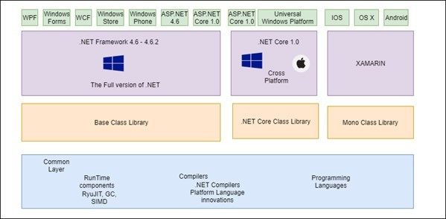
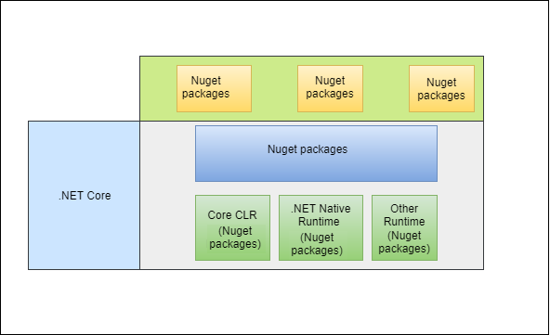
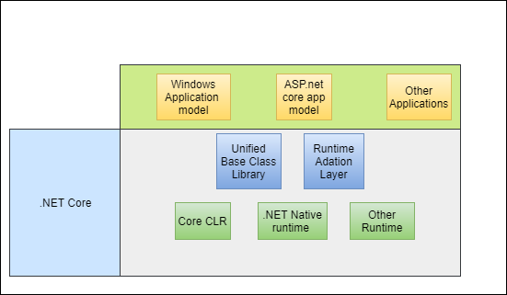
History of ASP.NET (2-2)
Modular .NET Core
.NET Framework and .NET Core
.NET Core Application Model

Slide 6
Uses and Features of ASP.NET (1-2)
Uses of ASP.NET
Facilitates creating Complex applications easily
Supports both Web-based and desktop-based applications Provides enhanced security due to Versatile and dynamic library Considerably reduces the code in large Web applications Provides What You See Is What You Get (WYSIWYG)
Offers server controls and blueprints having drag-and-drop facility
Allows easy modifications due to the separation of both HTML and source code

Slide 7
Uses and Features of ASP.NET (2-2)
Features of ASP.NET
All-Inclusive Software Infrastructure
Abstraction Layer
Supports Multiple Languages
Interactive Data HTTP Protocol Visual Studio

Slide 8
ASP.NET Page Lifecycle (1-6)
Page Lifecycle involves how ASP.NET deals with pages to generate results.
1
Requesting of page
2
Starting of page lifecycle
3
Initializing of page
4
Loading of page
5
Validating
Stages of an ASP.NET Page
6
Postback event handling
7
Rendering of page
8
Unloading
The lifecycle can be categorized into two types:
Application Lifecycle
Page Lifecycle

Slide 9
ASP.NET Page Lifecycle (2-6)
Code Snippet 1
<head>
<style type="text/css">
.auto-style1 { margin-right: 0px; margin-top: 7px;
}
</style>
</head>
<form id="form1" runat="server">
<p>
&nbsp;</p>
<p>
&nbsp;<asp:Label ID="Label1“ runat="server“Text="UserName"></asp:Label>
:&nbsp;
<asp:TextBox ID="TextBox1" runat="server" CssClass=
"auto-style1" Height="23px" Width="124px"></asp:TextBox>
</p>
<p>
<asp:Label ID="Label2" runat="server" Text="Password"></asp:Label>
:&nbsp;&nbsp;
<asp:TextBox ID="TextBox2" runat="server"></asp:TextBox>
</p>
<p> &nbsp;&nbsp;&nbsp;&nbsp;&nbsp;&nbsp;&nbsp; &nbsp;&nbsp;&nbsp;&nbsp; &nbsp;&nbsp;&nbsp;&nbsp;&nbsp;&nbsp;&nbsp; &nbsp;&nbsp;&nbsp;
<asp:Button ID="Button1" runat="server" Text="Submit" />
</p>
</form>

Slide 10
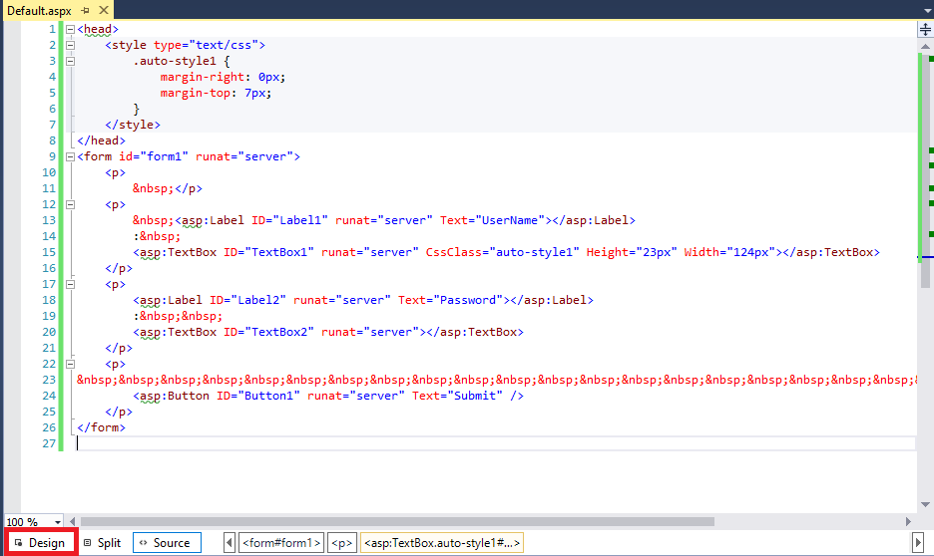
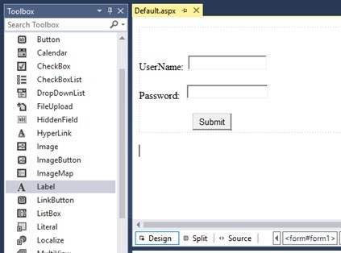
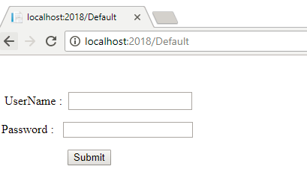
ASP.NET Page Lifecycle (3-6)
Page Design
Page with Markup Showing the Design Tab
Sample Output

Slide 11
ASP.NET Page Lifecycle (4-6)
Lifecycle of a Page when a New Request is Placed
Lifecycle of a Page in case of a Postback Event
1
2
3
4
5
6
7
8
9
Initializing
1
2
3
4
5
6
7
Initializing
Loading View State
Loading
Loading
PreRendering
Loading the postback data
Saving
PreRendering
Rendering
Saving state
Cleaning up
Rendering
Disposing
Unloading
Unloading

Slide 12
ASP.NET Page Lifecycle (5-6)
Events connected with the relevant page cycle phases:
PostBack Event Handling RaisePostBackEvent
Page PreRendering Phase
 | Page Initialization
Page_Init
View State Loading
Page_PreRender
LoadViewState
View State Saving
Postback Data Processing
SaveViewState
LoadPostData
Page Loading
Page Rendering
Page_Load
Page_Render
PostBack Change Notification
Page Unloading
RaisePostDataChangedEvent
Page_UnLoad

Slide 13
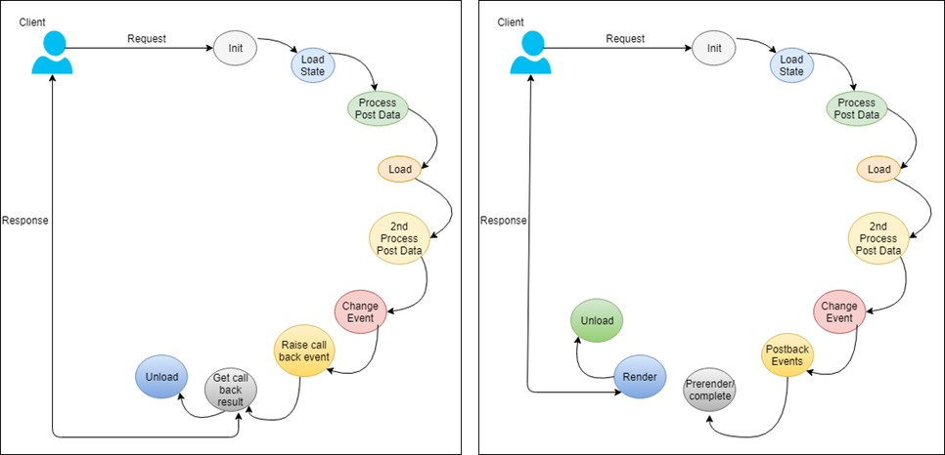
ASP.NET Page Lifecycle (6-6)
Processing of Controls (Postback and Callback)

Slide 14
ASP.NET Core Introduction (1-2)
ASP.NET Core is an open-source and cross-platform framework.
ASP.NET Core is supported by NuGet packages.
It facilitates easier development of modern Web apps, including cloud-based applications.
Apps can be executed on both .NET Core and .NET Framework.
Due to modular components, developers can retain flexibility.
They can create and execute apps on Windows, Mac OS, and Linux.

Slide 15
ASP.NET Core Introduction (2-2)
Improvements offered by ASP.NET Core
1
2
3
4
5
6
7
8
Streamlined Web development
A system that is set to work on cloud
Good community base
An integrated platform for creating a variety of Web applications and APIs
Assimilation of latest frameworks
Support for a flexible and lightweight HTTP request channel
Support for hosting itself in a targeted process or on different platforms
Simultaneous versioning of applications

Slide 16
ASP.NET Core Advantages
Supports Dependency Injection (DI)
Provides cross-platform compatibility
Has simplified MVC and WEB.API development
Focuses on increasing productivity Offers an open-source environment Promotes modularity

Slide 17
Choosing between ASP.NET and ASP.NET Core
ASP.NET Core | ASP.NET
Apps can be built either for Windows, MacOS, or Linux. | Apps can be built only for Windows.
Recommended when developing a Web UI as of ASP.NET Core 2.x is Razor Pages. | Recommended when developing a Web UI use Web Forms, SignalR, MVC, Web API, or Web pages.
Many versions can be utilized per machine. | Only one version can be utilized per machine.
Apps can be created with the help of Visual Studio, Visual Studio for Mac, or Visual Studio Code using C# or F#. | Apps can be created with the help of Visual Studio using C#, VB, or F#.
Performance is better than ASP.NET. | Performance is less than ASP.NET Core.
Choose either .NET Framework or .NET Core runtime. | Developers must use .NET Framework runtime.
Difference between ASP.NET or ASP.NET Core

Slide 18
Summary
Active Server Pages (ASP) was developed with an aim to generate Dynamic Web content.
Today, there are two versions of .NET Framework: a logical extension of the present version .NET 4.5.2, officially called .NET 4.6 and .NET Core 1.0.
ASP.NET lifecycle can be categorized into Application lifecycle and Page lifecycle.
The lifecycle of an ASP.NET page is based on whether the page request is new or a postback.
ASP.NET Core is a open-source and cross-platform framework that helps to create novel cloud-based Internet associated applications.
ASP.NET on the .NET Core 1.0 Framework offers the most adaptable version of ASP.NET.
ASP.NET is an established framework that offers all the elements necessary to develop enterprise- grade, server-based Web apps on Windows.
ASP.NET Core helps in developing apps on not just Windows operating system, but also on MacOS and Linux.

